Slide 1
Reconfigurable Systems: Applications

Slide 2
Applications
For speed-up
For power-efficiency
For reconfigurability

Slide 3
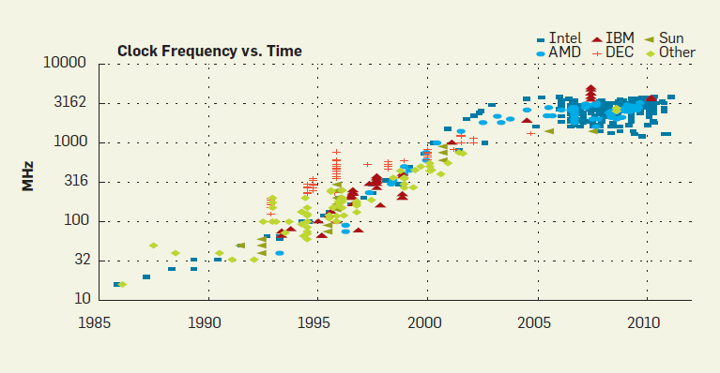
Reconfigurable Systems Advantages
Performance enhancement
Performance enhancement through scaling stopped
Architectures with highly parallel structures can fill the gap.

Slide 4
Speedups (repeated)
Reported speedups:
Up to x28500

Slide 5
Speedups (repeated)
SR: Super-Resolution:
Construction of high-resolution images from several low-resolution observations
Speedup: up to 4 orders of magnitude
[Georgis16]

Slide 6
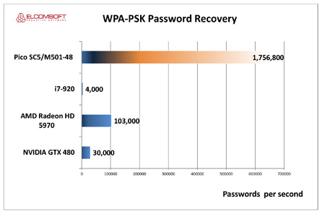
Speedups
Password guess:
Pico-FPGA board:
Xilinx Virtex-6 FPGA
i7-920:
Intel CPU
AMD Radeon:
AMD GPU
NVIDIA GTX 480
GPU
[ExtremeTech12]

Slide 7
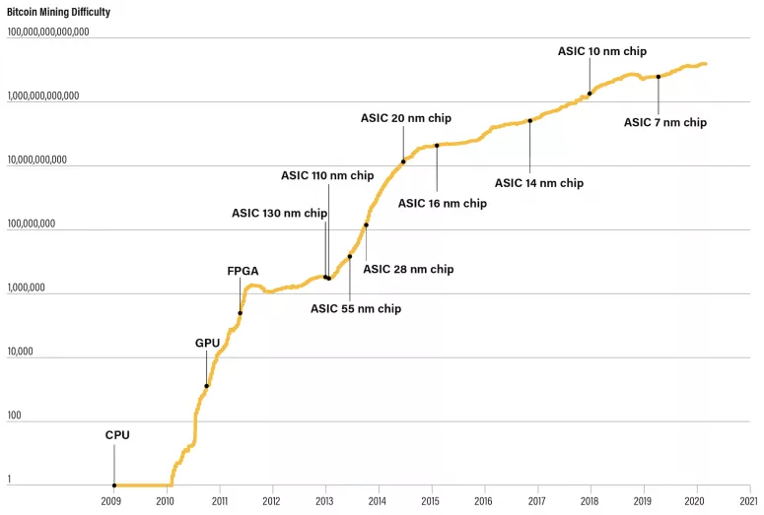
Speedups
Source: "The Evolution of Bitcoin Hardware" by Michael Bedford Taylor (University of Washington), CoinDesk Research

Slide 8
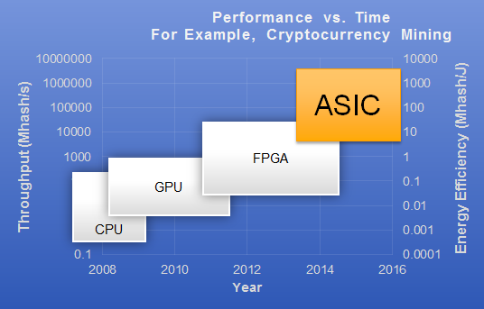
Speedups
Cryptocurrency mining:
Throuput and energy efficiency
[iSilicon16]

Slide 9
High-Performance Computing (HPC)
TOP500/Green500
Ranking of the 500 fastest and energy-efficient supercomputers since 1986/2007
Green500: Power-performance

Slide 10
HPC
HA-PACS:
University of Tsukuba
8th generation: adopted GPUs as computational nodes
GPUs could not share the data efficiently
Uses Stratix FPGA
164th place at the TOP500, 3rd place at the Green500

Slide 11
FPGA as a Network Chip
Difficult to increase the transceiver speed at the same pace as before in the next decade.
Must increase number of transceivers per FPGA

Slide 12
FPGA as a Network Chip
Network companies with network products with FPGA:
Exablaze
Arista
Cisco
Mellanox
Simplex

Slide 13
Big Data: Web Search
Web search engines:
Scan huge databases to find the Web pages containing keyword(s)
Web pages are scored and sorted in terms of their relevance with the keyword.
Past:
Built on PC-based server clusters
Present:
Large-scale data centers facing power wall
→ FPGA

Slide 14
Microsoft Bing Search Engine
Search procedure:
Queries (search terms) → servers → IFMs (Index File Managers)
Each IFM performs rank calculation on ~10,000–20,000 documents.
Results → servers → front-end
IFM:
Document score calculation: computation-intensive
→ FPGA-based accelerator

Slide 15
Microsoft Bing Search Engine
Score Calculation:
Feature extraction: many custom FSMs in FPGA
Software: 600 µs
FPGA: 4 µs
Machine learning scoring (MLS): final score calculation
Algorithm is frequently updated
→ Reconfigurability of FPGA
FPGA:
8 Stratix-based boards
FPGAs in Microsoft's Intelligent Cloud Computing

Slide 16
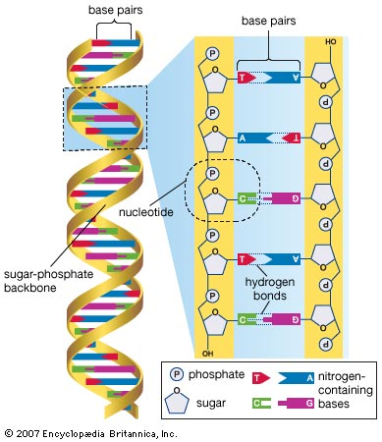
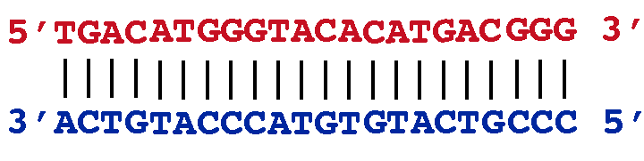
Bioinformatics: Genomics
Genome:
String of DNA molecules of size ~10⁹ for human
A (adenine)
T (thymine)
C (cytosine)
G (guanine)

Slide 17
Bioinformatics: Genomics
Genome analysis:
String processing algorithms
Acceleration by custom FSMs in FPGA
Data words: 2 bits
→ more suitable for FPGA (than CPU/GPU)

Slide 18
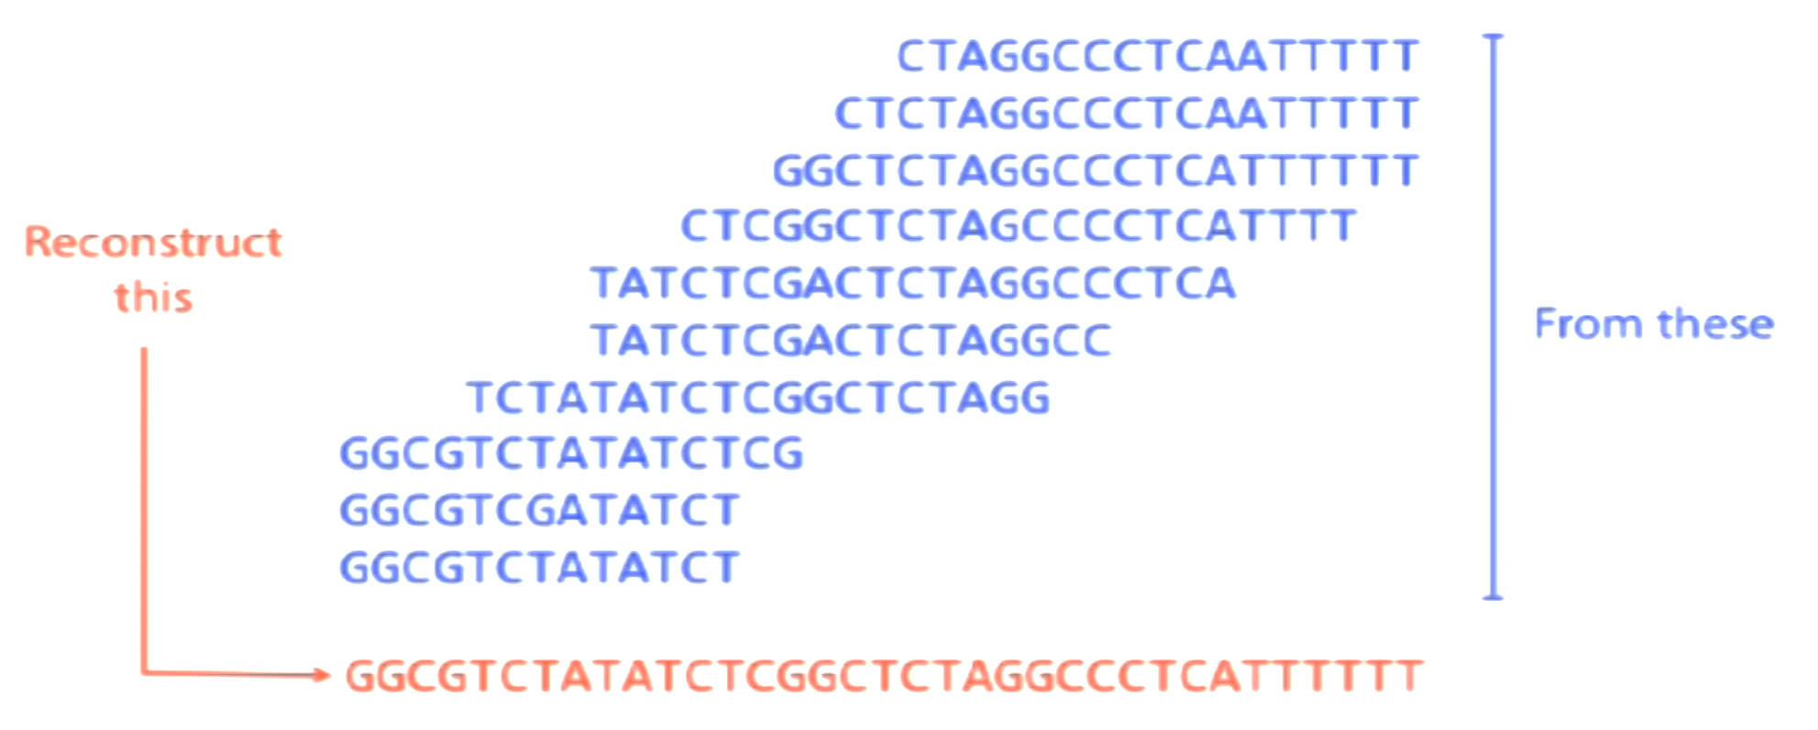
Genome Assembly from Short Reads
De Novo Genome assembly:
Read a massive number of short fragments of DNA (reads)
From short reads, Find overlaps on both ends
Construct the genome
No reference sequence used

Slide 19
Short Read Mapping on a Reference Genome
Human genome:
Everyone have a slightly different genome sequence
Differences: → medical interests (potential diseases, …)
Obtaining personal genome sequence:
By mapping DNA reads to reference human genome sequence
FPGA:
Massively parallel mapping

Slide 20
Deep Learning
Microsoft Azure Project:
Accelerated Machine Learning with Project Brainwave
Uses Intel FPGA
Video: Azure Accelerated Machine Learning with Project Brainwave

Slide 21
Power Efficiency
Power Consumption:
As a global issue
Power wall in chips

Slide 22
Power/Energy as a Global Issue
Energy consumption (if current rate):
By the year 2030, x30 growth only for ICT (Information and Communication Technology)
>> current total energy consumption for everything
More growth because of:
More Internet users
More IoT things
More social networks
More video on demand
More cloud computing
More electronic books
…

Slide 23
Power/Energy as a Global Issue
Greenhouse gas emission:
Currently higher than total air traffic
Electricity bill for data centers:
Google: Currently higher cost than its equipment
Soon: cost of a data center solely by monthly power bill
Google’s water-based data centers (on the ocean)

Slide 24
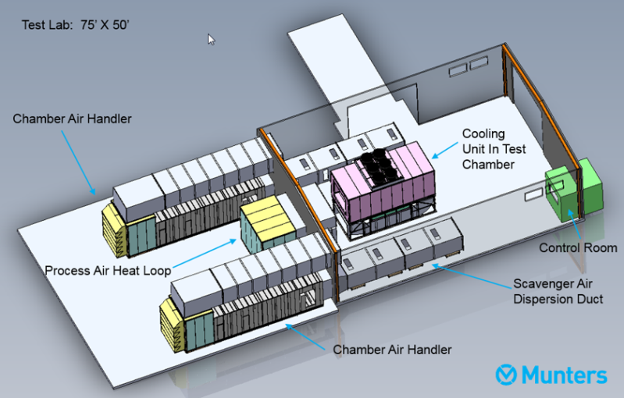
Cooling in Data Centers

Slide 25
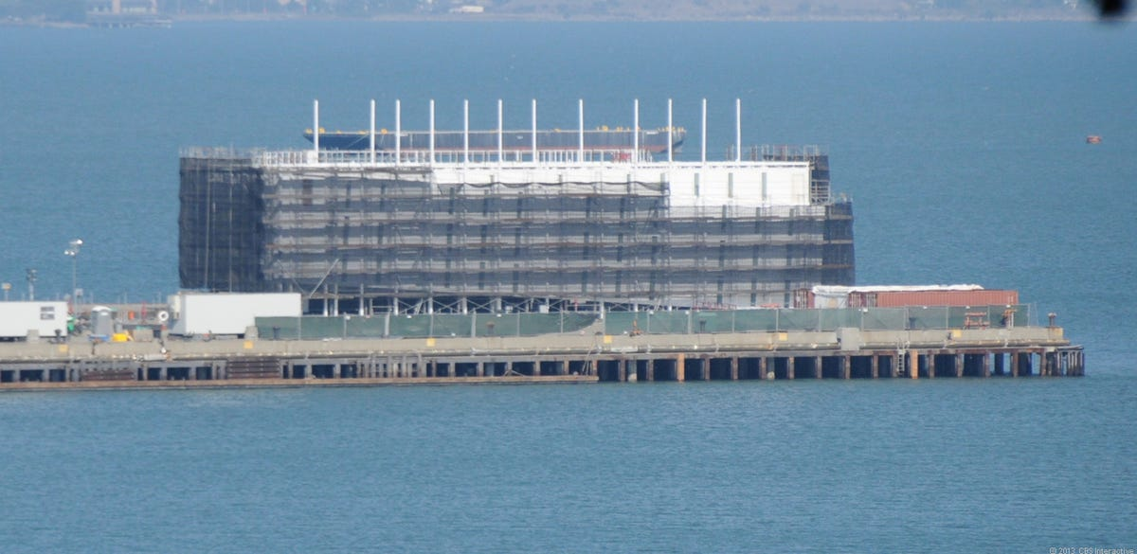
Google’s Floating Data Center

Slide 26
Power/Energy as a Global Issue
Limited oil production:
Peak production reached in 2009
Conclusion:
Computing performance: MIPS/W (not just MIPS)

Slide 27
Future High-Speed Systems
Power wall:
Frequency scaling:
20% to 30% per year
Supply voltage scaling (to keep power low):
-15% per tech. generation
Recent years: slowed down
→ Approaching power wall:
Max power that can be dissipated for a given chip area (~90 W/cm²)
No increase in frequency: not useful (static power)
Solution:
Dark silicon:
Keep parts of the chip off

Slide 28
Power Wall in Chips
Power wall:
Supply voltage does not scale as before (15% per year)
→ Power consumption is approaching its ultimate limit:
that can dissipate for a given chip area (~90 W/cm²)
→ Need to limit activity of transistors
Not sufficient due to static power
[Kaeli15]

Slide 29
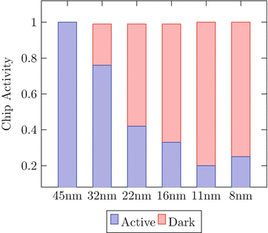
Power Wall in Chips (repeated)
Power wall:
Percentage of a microprocessor chip that can be ON (to keep within the available power budget)
[Kanduri17]

Slide 30
Power Wall in Chips
Limitation on available gate-density:
Future chips: more resources than what can be powered ON at any given time.
Efficient solution:
Heterogeneous architecture:
Most efficient core/module will be chosen dynamically for an application/task at hand.
→ Dynamic (on-demand) resource allocation in reconfigurable systems:
Install at a post-fabrication phase the most suitable core/accelerator for a certain task (rather than predicting at design time the most efficient architecture).

Slide 31
Future High-Speed Systems
Power wall:
Future chips: more resources than what can be powered ON at any given time.
Resource overhead of reconfigurable device NOT a limiting factor:
→ Extra area offer reconfigurability (flexibility) targeting:
reliability
performance enhancement

Slide 32
Applications for Reconfigurability

Slide 33
Reliability
Technology trend:
Shrinking feature size →
Less reliable transistors
Too many devices defective at manufacture time
Many devices fail over time (e.g., by aging)
More soft errors

Slide 34
Reconfigurable Systems Advantages
Reliability
Reconfigurable devices: excellent for fault tolerance:
Adapt to new faults on demand (e.g., aging)
Isolate defects
Correct defects
Provide spare resources to substitute defective blocks

Slide 35
Rapid prototyping
Verifying ASIC in real conditions before fabrication
High NRE costs
Software simulation
Relatively inexpensive
Slow
Accuracy?
Hardware emulation
Hardware testing under real operation conditions
Fast
→ Allows many more iterations
Accurate

Slide 36
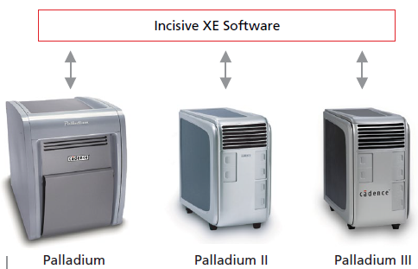
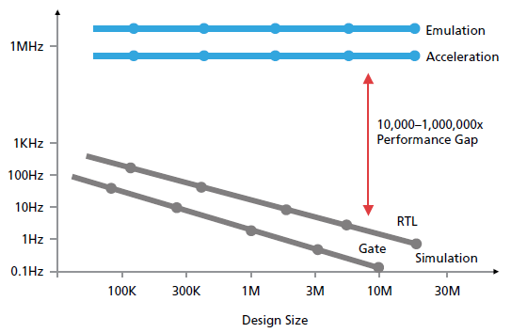
Cadence Palladium
hardware/software co-verification
Features:
Up to 1,000,000X faster than RTL simulation
Maximum capacity of up to 256M ASIC gates
Debug time:
from months to hours
Notes:
In terms of throughput (Hz): Number of test vectors per second

Slide 37
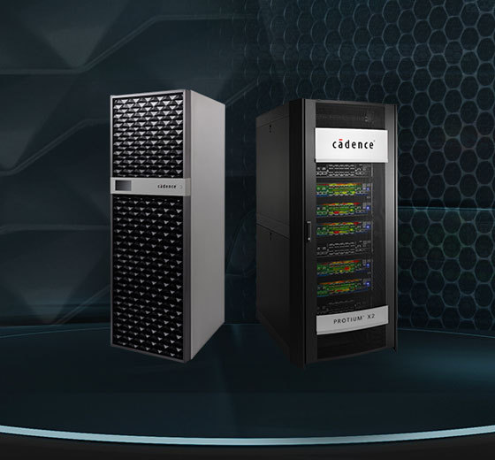
Cadence Protium X2
Protium X2
Xilinx UltraScale+
10 B gates in 10 hours

Slide 38
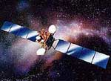
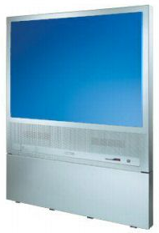
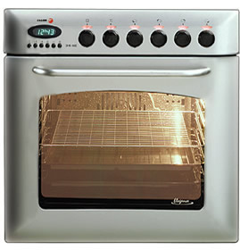
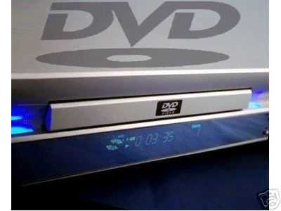
Post Fabrication Customization (repeated)
Time to market advantage
Ship the first version of a product
Remote upgrading with new product versions
Remote repairing
Manufacturer

Slide 39
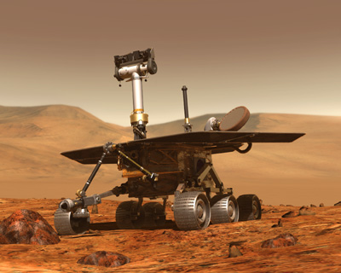
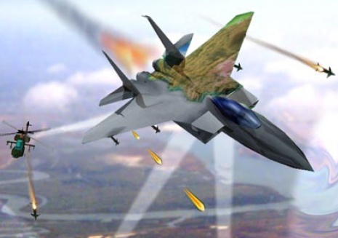
Adaptive Computing Systems
Uncertainty and unpredictability of some systems:
→ impossible, at compile time, to address all scenarios that can happen at run-time.

Slide 40
Adaptive Computing Systems
Adaptive computing systems:
Computing systems that are able to adapt their behaviour and structure to
changing operating and environmental conditions
time-varying optimization objectives,
physical constraints
e.g. changing protocols, new standards
Example:
Mars rover vehicle:
Some FPGAs can be modified from the earth.

Slide 41
References
Hideharu Amano, Principles and Structures of FPGAs, Springer, Singapore, 2018.
João M. P. Cardoso, Michael Hübner (eds.), Reconfigurable Computing: From FPGAs to Hardware-Software Codesign, Springer, New York, 2011.
Microsoft Co. (2019, April 8, Project Catapult, [Online]. Available:https://www.microsoft.com/en-us/research/project/project-catapult/#!videos
[Kaeli15] Kaeli, et al, Heterogeneous Computing with OpenCL 2.0, Morgan Kaufmann, 2015.
[Georgis16] Georgis, Georgios, George Lentaris, and Dionysios Reisis. "Acceleration techniques and evaluation on multi-core CPU, GPU and FPGA for image processing and super-resolution." Journal of Real-Time Image Processing (2016): 1-28.
[ExtermeTech16] Joel Hruska, “Intel launches Stratix 10: Altera FPGA combined with ARM CPU, 14nm manufacturing,” ExtremeTech, 2016.

Slide 42
References
Kanduri, Anil, Amir M. Rahmani, Pasi Liljeberg, Ahmed Hemani, Axel Jantsch, and Hannu Tenhunen. "A perspective on dark silicon." In The Dark Side of Silicon, pp. 3-20. Springer, Cham, 2017.

